Slide 1
STED Imaging of Live Cristae

Slide 2
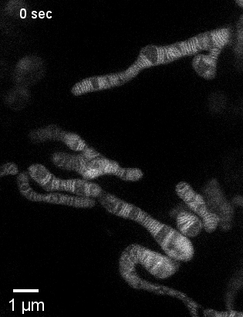
STED Imaging of Live Cristae
Cristae
  Human Mitochondria ~200-700nm. Gaps between cristae ~100nm. Crista diameter ~10nm.
  Have been imaged using electron microscopy many times.
The challenge then is to learn about the dynamics of cristae in living cells.
Authors labelled COX8A of HeLa cells with a SNAP-tag using CRISPR-Cas9.
  This would allow them to visualise the surface of the cristae with a variety of fluorophores
Thus, using STED, they created time-lapses of living cristae.

Slide 3
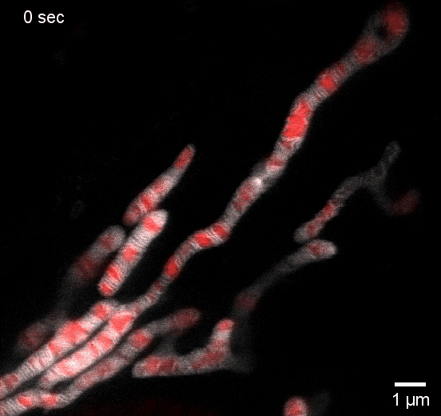
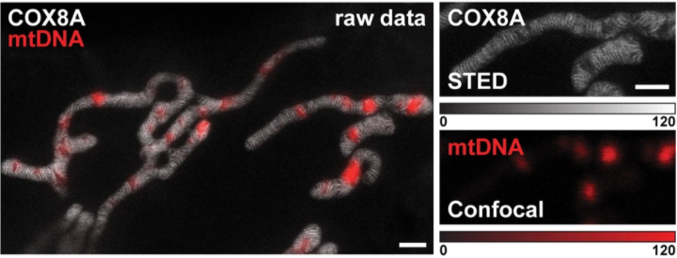
STED Imaging of Live Cristae
The authors noticed gaps between the cristae.
They labelled the mtDNA and imaged it confocally.
Concluded that, in these cells, mitochondrial nucleoids occupy voids between cristae.

